Slide 1


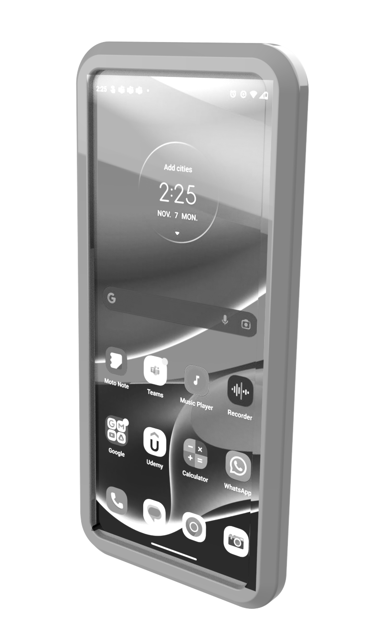
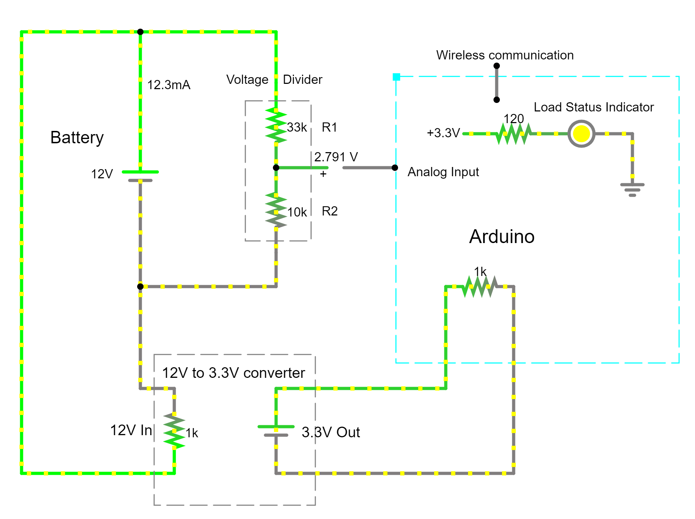
Battery Monitoring System
Cloud Service
AH<9
Our Product

